Slide 1
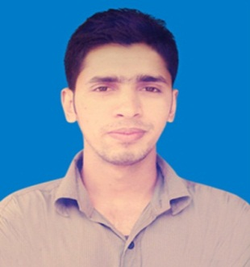









MD Aslam Hossain
+880 1680607293
aslamcsebd@gmail.com
Fb.com/aslam.cse.ctg
Full Stack Developer
CSE
Premier University, Chittagong.
Education
HSC
GPA: 3.00
Group: Science
Chittagong Biggan College, Chittagong
(2010-2012)
SSC
GPA: 4.88
Group: Science
Krismat Sreenagar Adarsha Secondary High School, Patuakhali
(2008-2010)
Front end web development
Complete Course
Registration No: 178680
Certificate No: 9/WD/CTG-10/0015
Training Time
24/07/2017 to 06/11/2017
Leveraging Information & Communication Technology (LICT)
Graduate ID: G023794 Batch Name: TOP000264
Preferred Training Type: Top-up IT Training (For OOP(Java))
Programming Language
C
Skill
JAVA
PHP
MySQL
Website Designing
HTML5
CSS3
Bootstrap
JavaScript & Jquery [Medium]
Photoshop [Medium]
Final Project: http://bazarinfo.ml/
Github: https://github.com/aslamctgcse/finalProject

Slide 2



Name : Md. Aslam Hossain
Father Name : Md Saiful Islam
Mother Name : Mst. Dalia Begum
Gender : Male
Date of Birth : 06-Aug-1994
National Id : 19941592828000054
Religion : Muslim
Guardian Mob : +880 1760376216 (Mother)
Personal Information
Agrabad, Katabodgass
Road: Jomir Uddin lain,
House: Mozno Mia buildring, 4th floor
Double Mooring, Chittagong-4100. Bangladesh.
Present Address
Village & P.O: Sreenagor,
Thana: Mirzagonj,
Dist: Patuakhali.
Barisal, Bangladesh.
Permanent Address

